Slide 1


K.RAMAKRISHNAN COLLEGE OF TECHNOLOGY
(AUTONOMOUS), TRICHY.
HOTEL RESERVATION SYSTEM
PRESENTED
DIKSHA S
2303811710422032
SUPERVISOR
Mr. M. Saravanan, M.E.,
AP/CSE.

Slide 2
PRESENTATION OVERVIEW
Objective
Project Introduction
Problem Statement
Methodologies (Programming concepts relevant to problem statement)
Architecture of the proposed system
List of Modules
Merits
Results and Discussion
Queries

Slide 3
OBJECTIVE
The objective for your "Hotel Reservation System" project in Java could be to create an efficient and user-friendly tool that simplifies the process of booking and managing hotel rooms.
This project aims to enhance the hotel management experience by providing a dynamic and interactive system to handle reservations, track room availability, and calculate costs, ensuring convenience for both customers and staff.

Slide 4
PROJECT INTRODUCTION
This project implements a basic Hotel Reservation System using Java's AWT (Abstract Window Toolkit).
The system allows users to book rooms, check availability, and calculate the cost of their stay.
It dynamically updates room availability and provides essential functionalities like clearing fields and displaying the current room status.

Slide 5
PROBLEM STATEMENT
The task is to create a Java-based GUI application for managing hotel room reservations. Users can input their name, select a room type, specify the number of days for their stay.
The application dynamically tracks room availability, calculates the total cost based on room type and duration, and displays reservation details. It validates user input to ensure all fields are correctly filled and provides error messages for invalid entries.
The application features a user-friendly design with labels, text fields, dropdown menus, buttons, and a text area, offering a seamless way to book rooms and view updated room availability in real-time.

Slide 6
METHODOLOGIES
1.Graphical User Interface (GUI):
Built using Java AWT for a simple and interactive experience.
2.Event Handling:
Action listeners for button interactions like room booking, clearing fields, and check availabilitiy.
3.Dynamic Updates:
Updates room availability in real-time after successful bookings.
4.Validation:
Ensures user inputs are complete and valid before processing bookings.

Slide 7
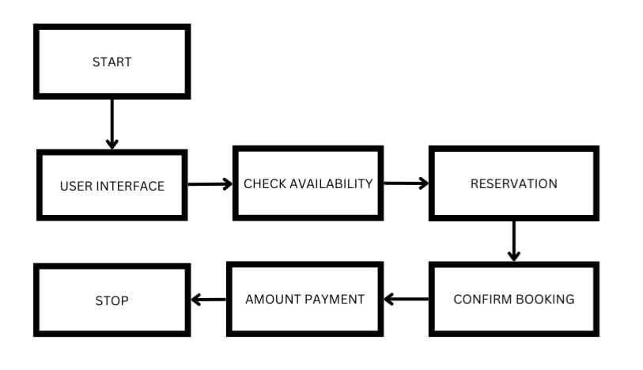
ARCHITECTURE OF THE PROPOSED SYSTEM

Slide 8
LIST OF MODULES
1.User Input Module:
Fields for name, room type, and duration of stay.
2.Room Availability Module:
Tracks and displays available room counts for Single, Double, and Suite rooms.
3.Cost Calculation Module:
Automatically computes the total cost based on the room type and duration.
4.Booking Confirmation Module:
Confirms reservations and updates room availability dynamically.
5.Reset Module:
Clears all fields and resets selections for new entries.

Slide 9
MERITS
1.User-Friendly Interface:
Simple and intuitive GUI for all users.
2.Dynamic Room Management:
Real-time updates to room availability after every booking.
3.Error Handling:
Validates input to avoid incomplete or invalid reservations.
4.Automation:
Automatically calculates total cost and updates room counts, reducing manual errors.
5.Efficient Booking Process:
Simplifies reservations with minimal user interaction.

Slide 10
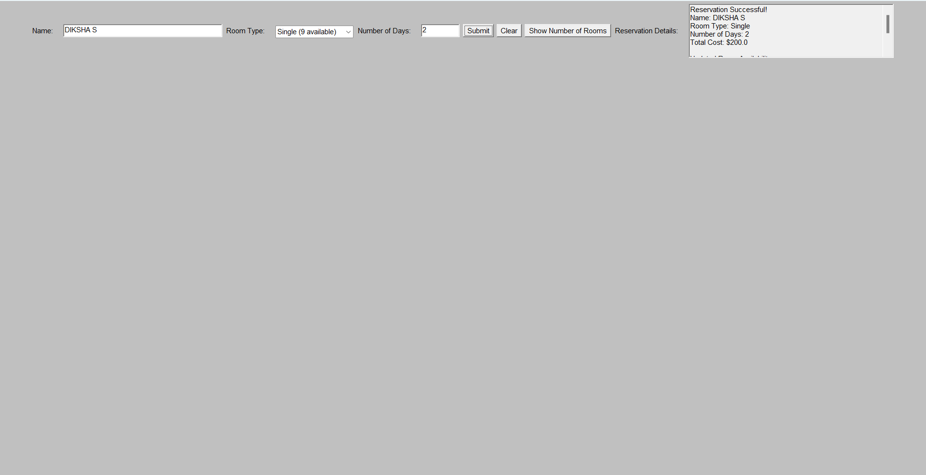
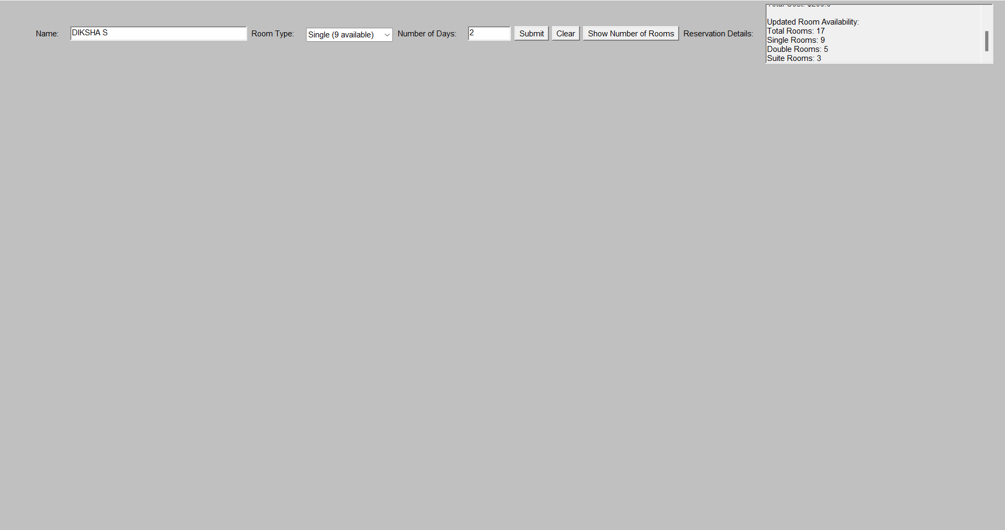
RESULTS AND DISCUSSION

Slide 11
QUERIES ?

